Slide 1
INTERNSHIP PROJECT REPORT
Data-Driven Modelling for Aerobody Design
A machine learning surrogate modelling framework — XGBoost, Ensemble XGBoost & MLP Regressor — integrated with Differential Evolution optimization for aerodynamic configuration design
XGBoost
Ensemble XGBoost
MLP Regressor
Differential Evolution
VELDI SAI KRISHNA
B.Tech, Computer Science Engineering (AI & ML) · Guru Nanak Institutions Technical Campus, Hyderabad
Internship Duration: 1 September 2025 – 27 February 2026
Aerodynamic Coefficient Prediction · Surrogate-Assisted Design Optimization

Slide 2
PROJECT OVERVIEW
02
Overview, Problem Statement & Objectives
Overview
Problem Statement
This project develops a data-driven modelling framework for aerodynamic configuration design and optimization. Machine learning surrogate models are trained on geometric and flight-condition data to rapidly predict aerodynamic coefficients (CL, CD, XCP, CN, CM), replacing costly, repeated high-fidelity simulations.
A typical aerodynamic configuration is arrived at through a fusion of empirical, numerical and experimental methods, plus experience from a baseline design — a process that is often sub-optimal. Data science offers a way to instead pursue a truly optimal aerodynamic configuration design.
ROLES & RESPONSIBILITIES DURING THE INTERNSHIP
1
2
3
4
5
Predict
Preprocess & Train
Optimize
Validate
Document
Build ML surrogate models to predict CL, CD, XCP, CN and CM
Normalize data and train XGBoost regression models per target
Integrate the surrogate with Differential Evolution optimization
Compare predicted vs. actual values and interpret validation plots
Record methodology, experiments and findings in a structured report

Slide 3
DATA & METHODOLOGY
03
Dataset, Preprocessing & Pipeline
Input Parameters
Target Outputs
Data Preparation
15 geometric configuration variables (nose, wing, tail geometry)
Mach number
Angle of attack (α)
Altitude
Lift coefficient (CL)
Drag coefficient (CD)
Center of pressure (X-C.P.)
Normal force & pitching moment (CN, CM) via MLP
~80% training / 20% testing split
Inputs normalized to [-1, 1] via min-max scaling
MLP branch: 64% / 16% / 20% train-val-test with StandardScaler
Same preprocessing applied at validation & inference
MODELLING & OPTIMIZATION PIPELINE
Aerodynamic
Dataset
›
Preprocessing &
Normalization
›
Surrogate Models
(XGBoost · Ensemble · MLP)
›
Differential
Evolution Search
›
Optimal
Configuration

Slide 4
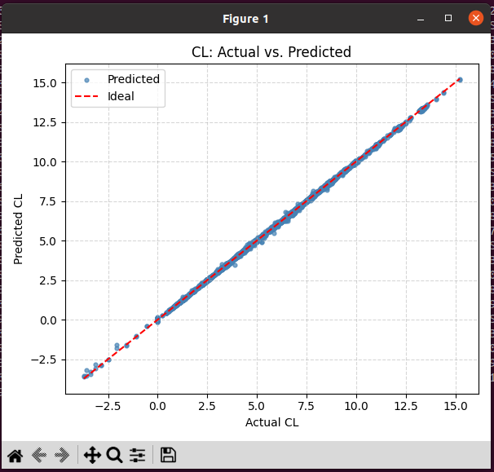
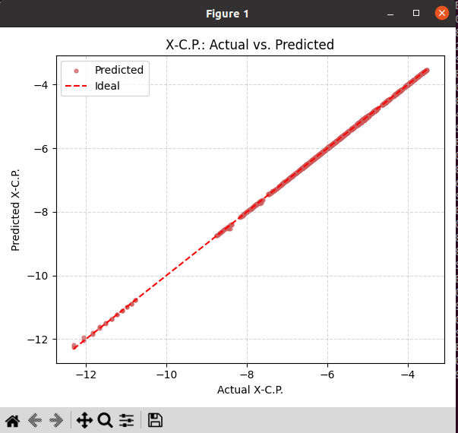
MODEL 1 · GRADIENT BOOSTING
04
XGBoost Regression — Predicting CL, CD & X-C.P.
Problem
Approach
Replace repeated high-fidelity simulations with a fast, accurate surrogate
Capture non-linear relationships between 15 geometric parameters + flight conditions (Mach, α, Altitude) and CL, CD, X-C.P.
Separate XGBoost regression model trained for each target (CL, CD, X-C.P.)
Hyperparameters: tree depth ≈10 · learning rate ≈0.1 · n_estimators ≈100 · subsample ≈0.8 · colsample_bytree ≈0.8
Evaluated via RMSE and actual-vs-predicted comparison
Result
Predicted values closely track actual CL and X-C.P. across the full range, with points falling tightly along the ideal (y = x) line — confirming the surrogate captures the underlying non-linear aerodynamic behaviour with minimal deviation.
CL: Actual vs. Predicted
X-C.P.: Actual vs. Predicted

Slide 5
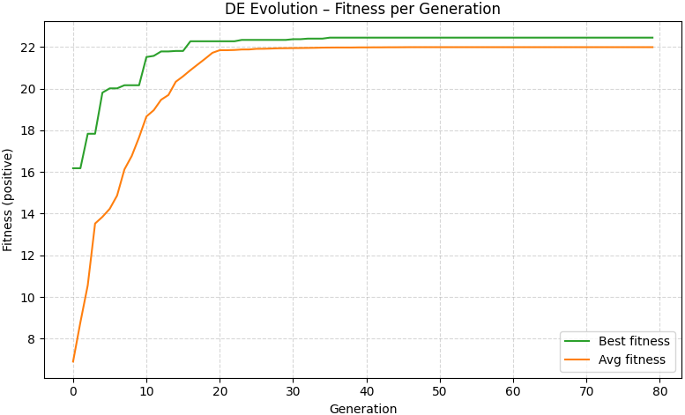
OPTIMIZER
05
Differential Evolution — Configuration Optimization
Problem & Approach
Find the optimal aerodynamic configuration across a high-dimensional geometry design space without exhaustively simulating every candidate
1) Initialization — candidate geometry vectors sampled within design bounds
2) Mutation — v = xr1 + F·(xr2 − xr3)
3) Crossover — mutant & target vectors combined via crossover probability (CR)
4) Selection — fitter of trial vs. target vector kept each generation
Fitness ∝ maximize CL/CD with stability constraints; terminates on generation limit or negligible fitness improvement
Optimization Result — Best & Average Fitness per Generation
FITNESS INPUTS, CONSTRAINTS & OUTPUT CONFIGURATION
Nose length
Body length
Wing LE
Root chord
Tip chord
178.81
2450.30
1668.85
526.97
879.67
Semi-span
Root thickness
Tip thickness
Wing sweep
Tail LE
1134.95
54.87
10.00
16.48
2846.45
Tail root chord
Tail tip chord
Tail semi-span
Tail root th.
Tail tip th.
241.98
79.58
12.05
84.12
81.11

Slide 6
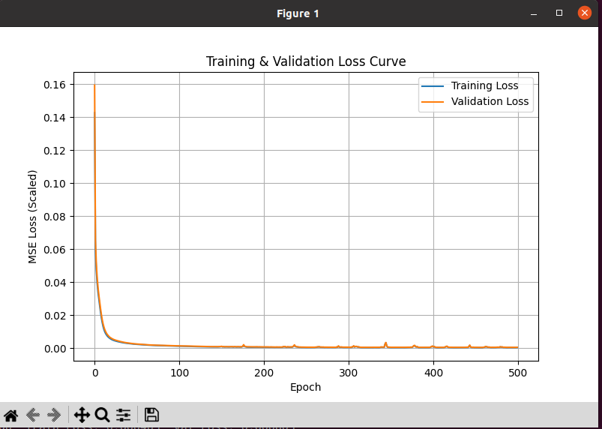
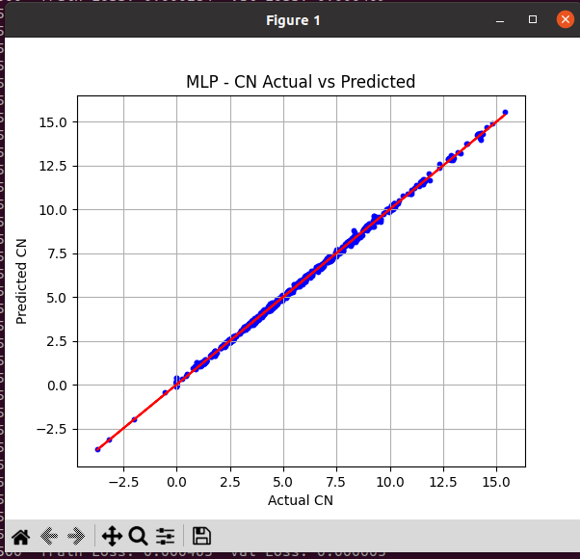
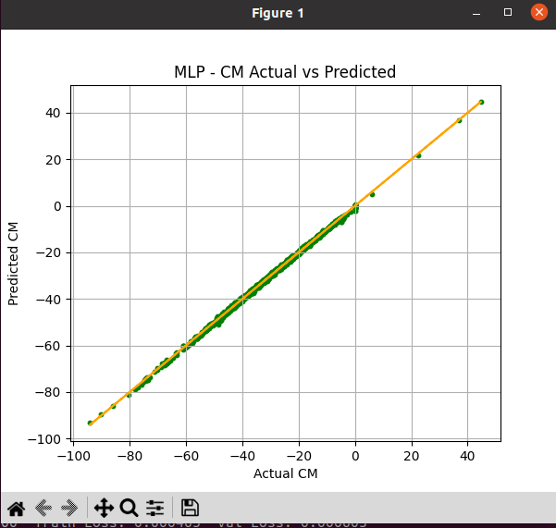
MODEL 2 · NEURAL NETWORK
06
Multi-Layer Perceptron (MLP) Regressor — Predicting CN & CM
Problem
Approach
CFD simulations & wind-tunnel testing for force/moment coefficients are expensive and slow
Goal: predict Normal Force Coefficient (CN) and Pitching Moment Coefficient (CM) directly from geometric and flight parameters
6 input features: ALPHA, MACH, X-C.P., nose length, semi-span, wing sweep
Architecture: Dense(64, ReLU) → Dense(64, ReLU) → Output (2 neurons: CN, CM)
Adam optimizer · 500 epochs · split 64% / 16% / 20% (train / val / test, seed 42) · StandardScaler normalization
RESULTS
CN — Training
CM — Training
CN — Test
CM — Test
MAE 0.0481 RMSE 0.0606
R² 0.9997
MAE 0.2686 RMSE 0.3418
R² 0.9996
MAE 0.0561 RMSE 0.0744
R² 0.9995
MAE 0.3059 RMSE 0.4050
R² 0.9995
Training & Validation Loss Curve (500 epochs)
CN: Actual vs. Predicted
CM: Actual vs. Predicted

Slide 7

MODEL 3 · ENSEMBLE
07
Ensemble XGBoost — Why, What & How
Why Ensemble?
What Is Taken (Features)
How the Output Comes
Aerodynamic relationships are highly nonlinear, feature-interactive, piecewise smooth, and sometimes discontinuous near stall regions
A single model can be sensitive to random initialization
Averaging multiple independently-seeded models reduces variance, initialization sensitivity, and overfitting noise
Geometry: nose length, body length
Wing: LE, root/tip chord, semi-span
Thickness: root/tip th. · Sweep: wing sweep
Tail: LE, root/tip chord, semi-span, thickness
Flight state: MACH, ALPHA, ALT
Targets: CL, CD, X-C.P. (own ensemble each)
5 XGBoost regressors trained per target with seeds 10, 20, 30, 40, 50
Same 80% training data & hyperparameters as the single model
Final prediction is the mean of the 5 model outputs (see formula below)
Ensemble Prediction Formula
Effect
This reduces prediction variance, sensitivity to random initialization, and overfitting noise — giving a smoother, more reliable surrogate than any single XGBoost model. XGBoost is well suited as the base learner because it captures nonlinear feature interactions, is robust to outliers, is less sensitive to feature scaling, and generalizes strongly on tabular aerodynamic data.

Slide 8
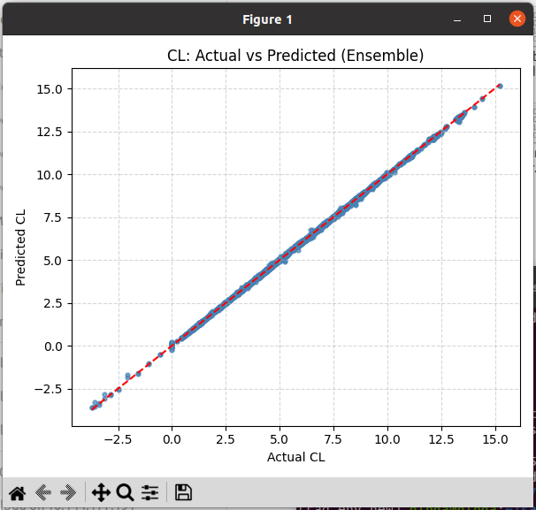
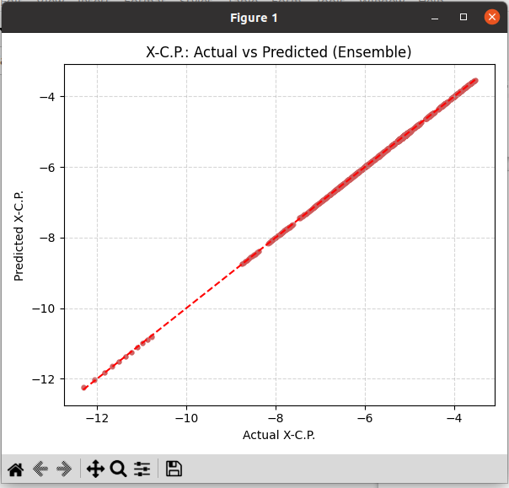
MODEL 3 · ENSEMBLE
08
Ensemble XGBoost — Results
PERFORMANCE (5-MODEL AVERAGE)
CL — Train
CD — Train
XCP — Train
CL — Test
CD — Test
XCP — Test
MAE 0.0128
RMSE 0.0196
R² 1.0000
MAE 0.0044
RMSE 0.0072
R² 1.0000
MAE 0.0013
RMSE 0.0022
R² 1.0000
MAE 0.0247
RMSE 0.0438
R² 0.9998
MAE 0.0087
RMSE 0.0174
R² 0.9998
MAE 0.0021
RMSE 0.0040
R² 1.0000
CL: Actual vs. Predicted (Ensemble)
X-C.P.: Actual vs. Predicted (Ensemble)

Slide 9
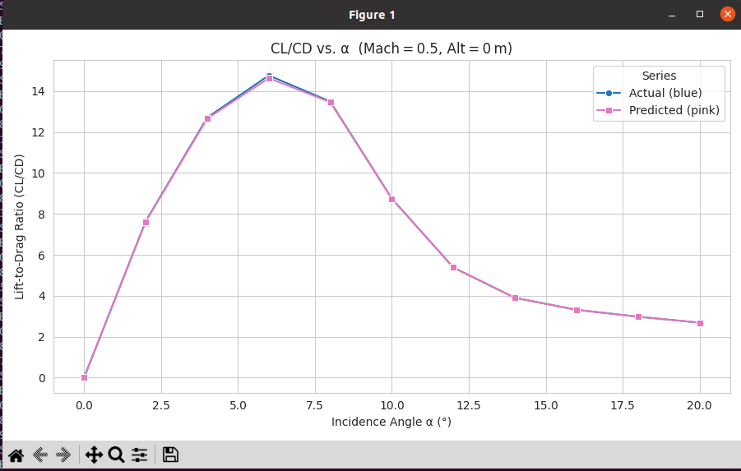
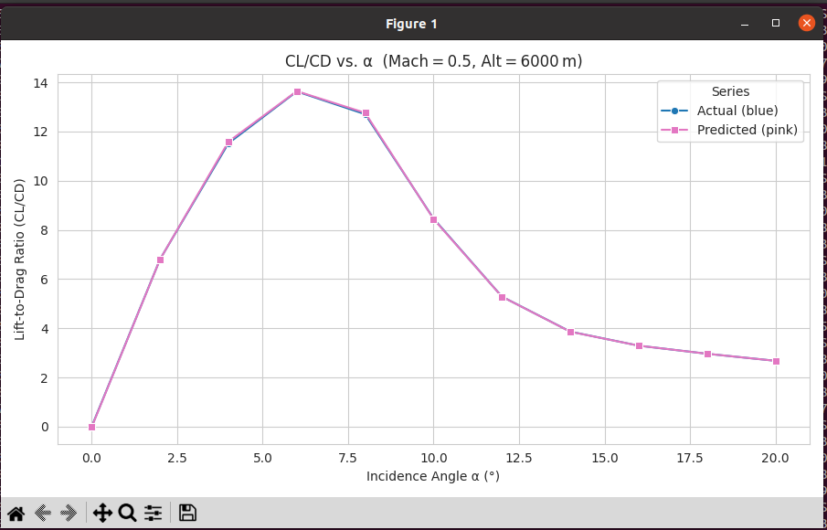
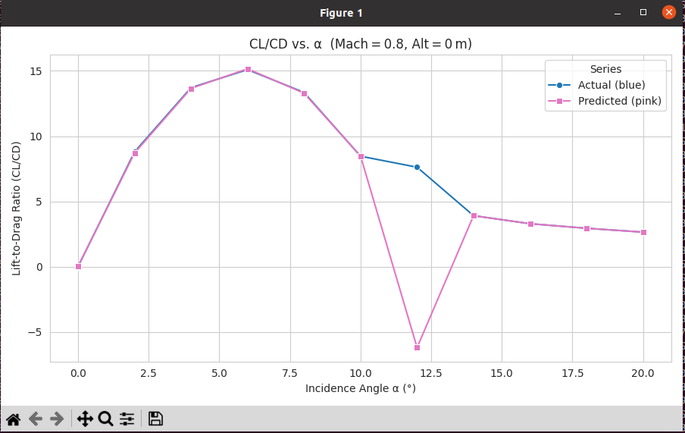
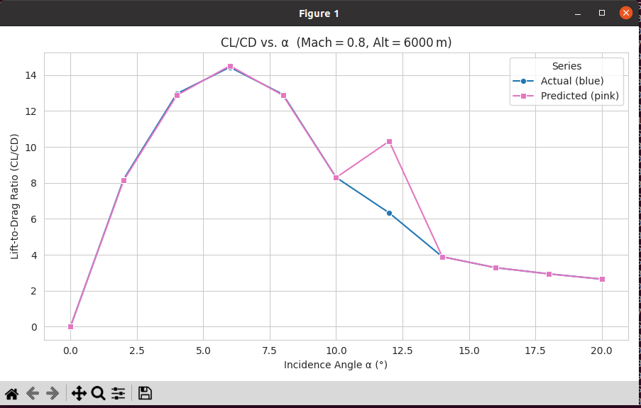
VALIDATION
09
Model Validation — CL/CD vs. Angle of Attack (α)
CL/CD vs. α was plotted from the trained XGBoost surrogate across different Mach numbers and altitudes, using both uniform weighting and a variable weighting scheme (higher weight near α = 4°–8°, tapering toward the extremes). Predicted values overlay actual values closely across the operating range, validating the surrogate's accuracy across the flight envelope.
Mach = 0.5, Altitude = 0 m
Mach = 0.5, Altitude = 6000 m
Mach = 0.8, Altitude = 0 m
Mach = 0.8, Altitude = 6000 m

Slide 10
FINAL RESULT
10
Finalized Surrogate Model
Ensemble XGBoost
Selected as the finalized production model for CL, CD and X-C.P. prediction
0.9998
0.9998
1.0000
CL R² (Test)
CD R² (Test)
X-C.P. R² (Test)
Why Ensemble XGBoost Was Chosen
Role in the Full Pipeline
Highest, most stable accuracy of all models tested (R² ≈ 1.00 on train, ≥ 0.9998 on test for every target)
Averaging 5 seeded models reduces variance and overfitting noise versus a single XGBoost model
Differential Evolution uses this finalized surrogate as its fitness function to search for optimal configurations
Complementary model: MLP Regressor handles CN & CM prediction (R² ≈ 0.9995 on test)

Slide 11
WRAP-UP
11
Results, Learnings & Conclusion
Key Results & Conclusion
Key Learnings & Future Scope
XGBoost-based surrogate models (single & ensemble) accurately predict CL, CD and X-C.P. across geometric configurations and flight conditions
Integration with Differential Evolution enabled efficient exploration of the design space, yielding improved lift-to-drag ratio, reduced drag, and stable aerodynamic behaviour
The framework evaluated thousands of configurations at a fraction of the computational cost of CFD-based optimization
Provides a reliable, fast and computationally efficient alternative to traditional simulation-based aerodynamic design
Gained hands-on experience in surrogate modelling, hyperparameter tuning, and validation using RMSE/R² metrics
Understood how mutation, crossover and selection guide Differential Evolution toward optimal, constraint-feasible designs
Realized how ML + evolutionary optimization together cut computational cost versus traditional CFD workflows
Future scope: extend the approach to more complex vehicle configurations and broaden training data coverage
Machine learning–driven surrogate modelling combined with evolutionary optimization is a reliable, fast and computationally efficient alternative to conventional simulation-based aerodynamic design.

